Slide 1
How to frame a good question / Objective
Dr. Vijayakumar. K
Dept of Community Medicine,
Dr. S.M.C.S.I . Medical College, Karakonam
Thiruvananthapuram

Slide 2
Objective of the session

Slide 3
How a research idea is generated
What are the qualifications of a good research objective
Refining a research question / Objective
The link between Objective and
The title
Methods
Analysis
Conclusion

Slide 4
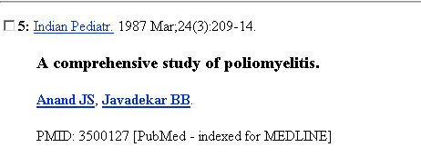

Slide 5
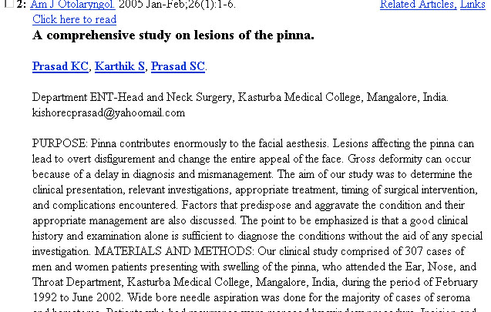

Slide 7
The research idea
Begins from an uncertainty about a health issue
The first challenge is to find an important one
Transform into a feasible and valid study plan

Slide 8
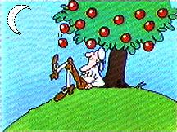
Where do ideas come from?
Pure inspiration (rare)
Critical reading of published papers
A conference or seminar
Observing patients
Speaking to other researchers
New technologies bring in new questions
A doubt raised by a colleague

Slide 9
Good ideas come to…..
The prepared mind
One with a skeptical attitude about prevailing beliefs.

Slide 10
Framing the research question
A general idea has to be converted into a research question

Slide 11
The research question / objective
Topic
Idea
Question
Operationalizing the question
Measurable variables
Refining the question

Slide 12
Narrowing down to the research question
Topic
Idea
Question
Refining the research question

Slide 13
How do we formulate a good research question?- Operationalising
Striking the balance between “Idea” and “feasibility”
Idea – Novel, Interesting, Relevant
Feasibility – Measurability, Affordability (Resources)
Ethical
Impact

Slide 14
Functions of research question
Provide a clear focus for the study
Determine the design of the project
Specify the population.
Identify the sample

Slide 15
Functions of research question-2
5. Describe the variables in terms that can be measured
6. Guide data collection
7. Framework for data analysis
8. Drawing conclusions

Slide 16
The research question
What
Who
Where
How
0. Why (Philosophy)

Slide 17
The research question
What – measurable variables
Who – subjects, controls
Where - location
How - method

Slide 18
Measurable entities
do what to whom for how long to achieve what effect?’
Be as specific as possible
‘moderate reduction of smoking habit’
‘40% reduction in smoking prevalence’
‘audio visual health education’
‘video programmes of 30 minutes duration aired two times a month for 6 months’

Slide 19
The research objective develpt-1
Topic – DM
Idea – early occurrence of DM
Objective – is to identify proportion of young age DM
Operationalizing the objective –compare the prevalence of young age DM with …….what?
Refine the objective further

Slide 20
The research objective develpt-2
Topic – Esophageal cancer
Idea – High incidence - What are the causes? Is consumption of salted fish a cause?
Question – What are the causes of esophageal cancer ?
Operationalizing the question – What are the risk factors of esophageal cancer
Refine the question further

Slide 21
The research question
Refining the question further
What are the risk factors for Squamous cell carcinoma of the esophagus in patients admitted to Karpagam Medical college hospital, as compared to age and sex matched controls from the surgery wards of the same hospital who do not have gastrointestinal malignancy?

Slide 22
The research question
Is regular consumption of salted fish (average of at least once a week for 5 years ) a risk factor for Squamous cell carcinoma of the esophagus in patients admitted to Karpagam medical college hospital, as compared to age and sex matched controls from the surgery wards of the same hospital who do not have gastrointestinal malignancy?

Slide 23
The research question
What – measurable variables
risk factors
Squamous cell carcinoma of the esophagus
Who – subjects, controls
patients admitted
age and sex matched controls who do not have gastrointestinal malignancy
Where – location
Savitha medical college hospital
How – method
compare

Slide 24
Should the question be all inclusive?
“ Among competent, consenting patients with recent transient ischaemic attacks or partial strokes in the circulation of the carotid artery, and ipsilateral stenosis of 70% to 99%, as judged by expert central review of selective angiograms, who are receiving optimal medical care and do not have elevated surgical risk does the addition of carotid endarterectemy,by surgeons who have an established 30 day perioperative complication rate of less than 6% for persistent stroke or death,reduce the subsequent risk of major stroke and stroke death over a period of 5 years, compared to patients who receive optimal medical care but do not receive CE”

Slide 25
What do we do with secondary questions?
Questions are not to be data driven
Add on questions should never compromise the primary question
Problems
Burden of data collection
Compromise the Willingness of investigators and participants
Budget issues

Slide 26
Acknowledgements: some slides are drawn from following luminaries
1.DR KP Aravindan (professor of pathology, MC Calicut).
2.Dr Zinia ,(Associate professor, community medicine department , MC TVPM).
3.Dr Soumya Gopakumar (Asst Professor, SMCSI Medical College, Karakonam, TVPM)

Slide 27
Thank you

